Slide 1


Saundarya
27-06-2025

Slide 2

Outline
Executive Summary
Introduction
Methodology
Results
Conclusion
Appendix

Slide 3
Executive Summary
Summary of methodologies
Data Sources: SpaceX API, Wikipedia, Yahoo Finance
Tools: Pandas, BeautifulSoup, SQL, Plotly, Folium, Scikit-learn
Techniques: Data wrangling, EDA, SQL analytics, mapping, classification (LogReg, SVM, KNN, Tree)
Summary of all results
Most launches from CCAFS SLC 40 and KSC LC 39A
LEO orbit has highest success rate
Success rate drops for payloads >6000 kg
SVM gave highest accuracy (~84%)
Folium map visualized launch clusters and success
SQL showed most failures in early years, success improved over time

Slide 4
Introduction
Project background and context
SpaceX aims to revolutionize space travel by reducing costs and increasing reliability. Understanding launch patterns and success factors is critical to optimizing missions.
Problems Statement
How can data science help uncover key patterns in SpaceX launches and predict mission success?
Key Questions?
What launch sites and payloads correlate with higher success?
How do orbital destinations impact outcomes?
Can we predict launch success using machine learning?

Slide 5

Section 1

Slide 6
Methodology
Executive Summary
Data collection methodology:
Collected SpaceX launch data from APIs, HTML tables, and static JSON/CSV files.
Perform data wrangling
Cleaned data: handled nulls, converted types, extracted & standardized features.
Perform exploratory data analysis (EDA) using visualization and SQL
Perform interactive visual analytics using Folium and Plotly Dash
Perform predictive analysis using classification models
Built classification models (Logistic Regression, SVM, KNN, Decision Trees).
Used GridSearchCV for hyperparameter tuning and cross-validation.
Evaluated models using accuracy on test data to identify the best performer.

Slide 7
Data Collection
Describe how data sets were collected.
Yahoo Finance API – Historical stock data for Tesla, GameStop, Amazon
Web Scraping – Revenue data for Tesla and GameStop using BeautifulSoup
Static JSON API – SpaceX launch data (launch records and metadata)
Wikipedia Tables – SpaceX launch history and booster information
You need to present your data collection process use key phrases and flowcharts
Data Sources (APIs, websites, databases)
Extract Data (web scraping, SQL queries)
Store Raw Data (CSVs, Cloud Storage)
Clean & Prepare (Remove duplicates, handle missing values)

Slide 8
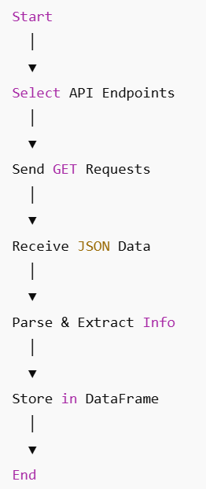
Data Collection – SpaceX API
Present your data collection with SpaceX REST calls using key phrases and flowcharts
Select relevant SpaceX API endpoints (e.g., launches, rockets)
Send GET requests to fetch data
Receive JSON formatted responses
Parse JSON to extract necessary fields
Store extracted data into Pandas DataFrames
Clean and prepare data for analysis
Add the GitHub URL of the completed SpaceX API calls notebook (must include completed code cell and outcome cell), as an external reference and peer-review purpose
Place your flowchart of SpaceX API calls here

Slide 9
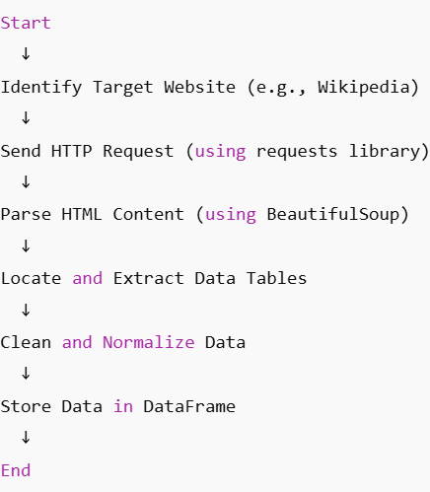
Data Collection - Scraping
Present your web scraping process using key phrases and flowcharts
Identify target web pages (e.g., Wikipedia SpaceX launch tables)
Send HTTP requests to fetch HTML content
Parse HTML using BeautifulSoup
Locate relevant tables and extract rows
Clean and normalize extracted data
Store data in structured format (Pandas DataFrame)
Add the GitHub URL of the completed web scraping notebook, as an external reference and peer-review purpose
Place your flowchart of web scraping here

Slide 10
Data Wrangling
Load raw data
Describe how data were processed
Load raw data from CSV, API, and web scraping
Handle missing or inconsistent values (drop/fill)
Rename and format columns for clarity
Parse and split date/time fields
Extract new features from existing data
Remove irrelevant or duplicate records
Validate data quality and consistency
Save cleaned data for analysis
Clean missing/inconsistent values
Format columns and extract features
Remove duplicates and irrelevant data
Save cleaned dataset

Slide 11
EDA with Data Visualization
Summarize what charts were plotted and why you used those charts
Bar charts: Show success rates by orbit types to identify performance trends
Scatter plots: Explore relationships between payload mass, flight number, and orbit types
Catplots: Compare flight numbers across launch sites and success classes
Line charts: Track yearly success rate trends
Maps: Visualize launch site locations and outcomes interactively

Slide 12
EDA with SQL
Using bullet point format, summarize the SQL queries you performed
Filtered launches with non-null dates to create a clean dataset
Listed boosters with successful drone ship landings and payload mass between 4000-6000 kg
Counted total successful and failed mission outcomes
Identified booster versions carrying the maximum payload using subqueries
Queried failure landing outcomes in drone ship for launches in 2015 by month
Ranked landing outcomes count between specific dates in descending order
Compared model accuracies based on SQL-filtered data for classification tasks

Slide 13
Build an Interactive Map with Folium
Summarize what map objects such as markers, circles, lines, etc. you created and added to a folium map
Explain why you added those objects
Circles: Marked launch site locations to highlight geographic distribution
Markers: Labeled launch sites with names for easy identification
Marker Clusters: Grouped launch events to visualize success/failure outcomes compactly
Lines (Polylines): Connected launch sites to closest coastlines to show distances
Popup Labels: Displayed detailed info on hover, like launch site names or distances

Slide 14
Build a Dashboard with Plotly Dash
Summarize what plots/graphs and interactions you have added to a dashboard
Explain why you added those plots and interactions
Plots/Graphs:
Scatter plots (e.g., Payload Mass vs. Orbit, Flight Number vs. Launch Site) to show relationships
Bar charts for success rates by orbit type to identify patterns
Line charts showing success rates over time for trend analysis
Interactions:
Dropdown filters for selecting orbit types or launch sites
Hover tooltips displaying detailed data points
Zoom and pan features for map and plots
Why: These plots and interactions enable users to explore data dynamically, uncover patterns, compare launch outcomes, and gain insights into factors influencing mission success.

Slide 15
Predictive Analysis (Classification)
Summarize how you built, evaluated, improved, and found the best performing classification model
You need present your model development process using key phrases and flowchart
Build: Selected classification algorithms (Logistic Regression, SVM, Decision Tree, KNN)
Preprocess: Standardized features and encoded categorical variables
Split: Divided data into training (80%) and testing (20%) sets
Tune: Used GridSearchCV with 10-fold cross-validation to find best hyperparameters
Evaluate: Measured accuracy on test set for each model
Improve: Compared models, selected best performer based on accuracy
Outcome: Best model chosen for final predictions

Slide 16
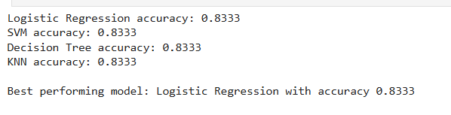
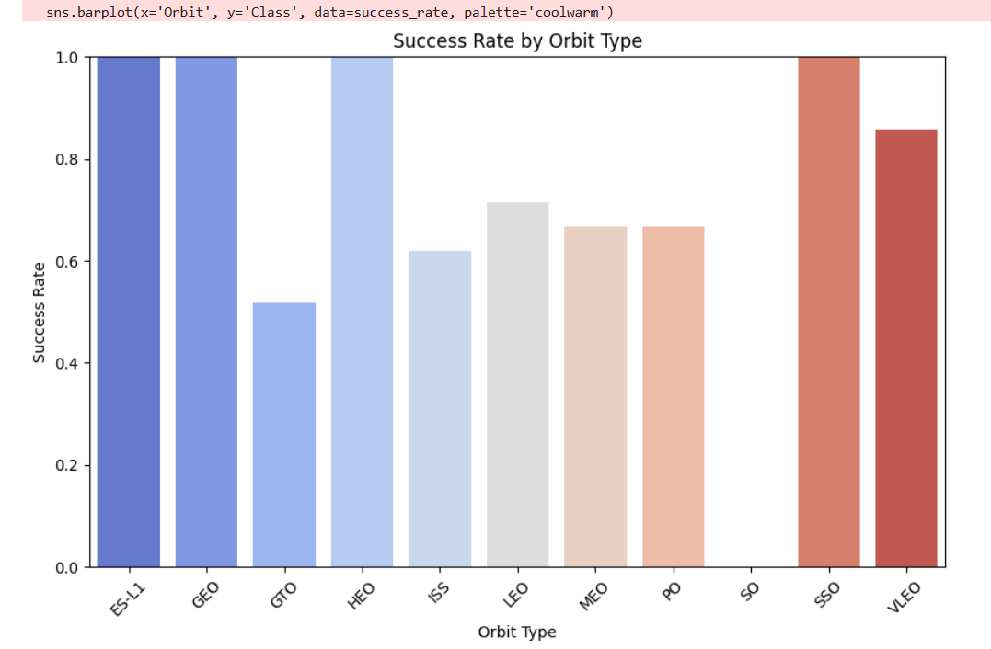
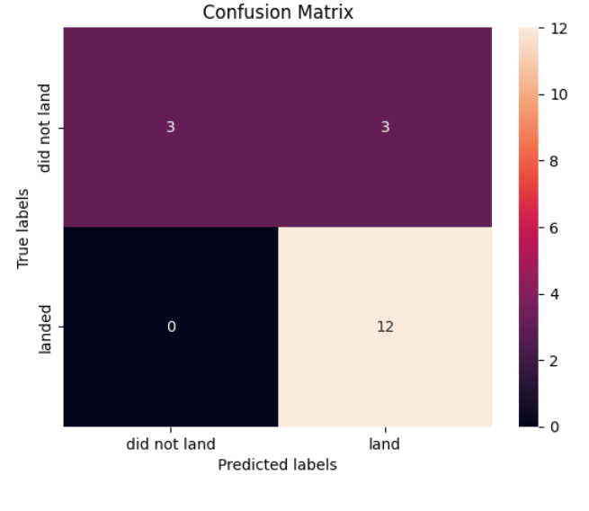
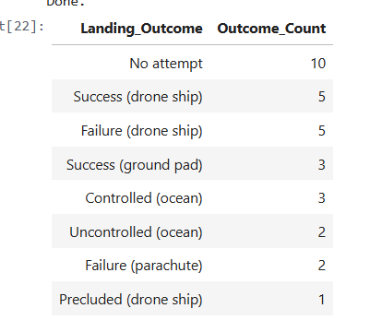
Results
Exploratory data analysis results
Interactive analytics demo in screenshots
Predictive analysis results

Slide 17

Section 2

Slide 18
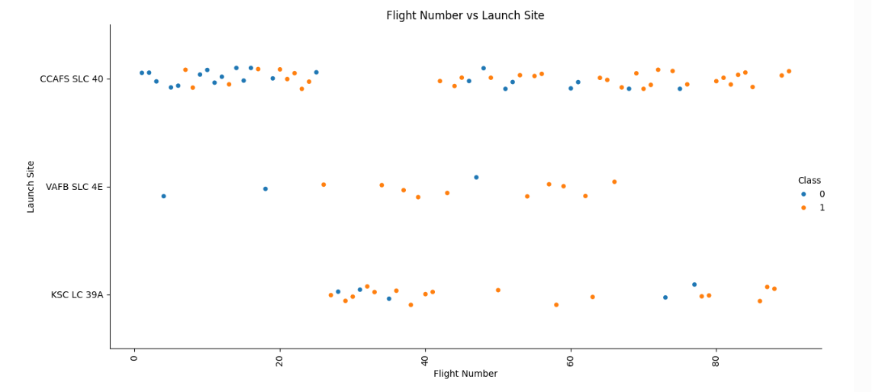
Flight Number vs. Launch Site
Show a scatter plot of Flight Number vs. Launch Site
Show the screenshot of the scatter plot with explanations
Shows how often each launch site was used over time
X-axis: Flight Number (order of launches)
Y-axis: Launch Site
Color: Success (1) or Failure (0)
Helps spot site usage trends and success patterns

Slide 19
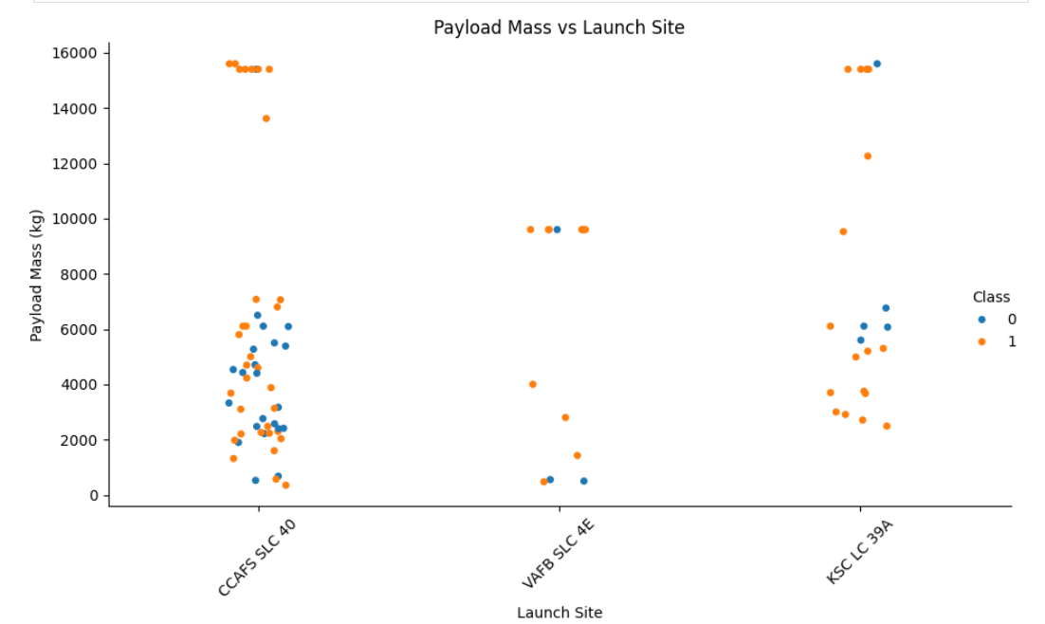
Payload vs. Launch Site
Show a scatter plot of Payload vs. Launch Site
Visualizes the Payload Mass for each Launch Site
X-axis: Payload Mass (kg)
Y-axis: Launch Site
Color-coded by mission success (class)
Helps identify which sites handled heavier payloads and their success rates
Show the screenshot of the scatter plot with explanations

Slide 20
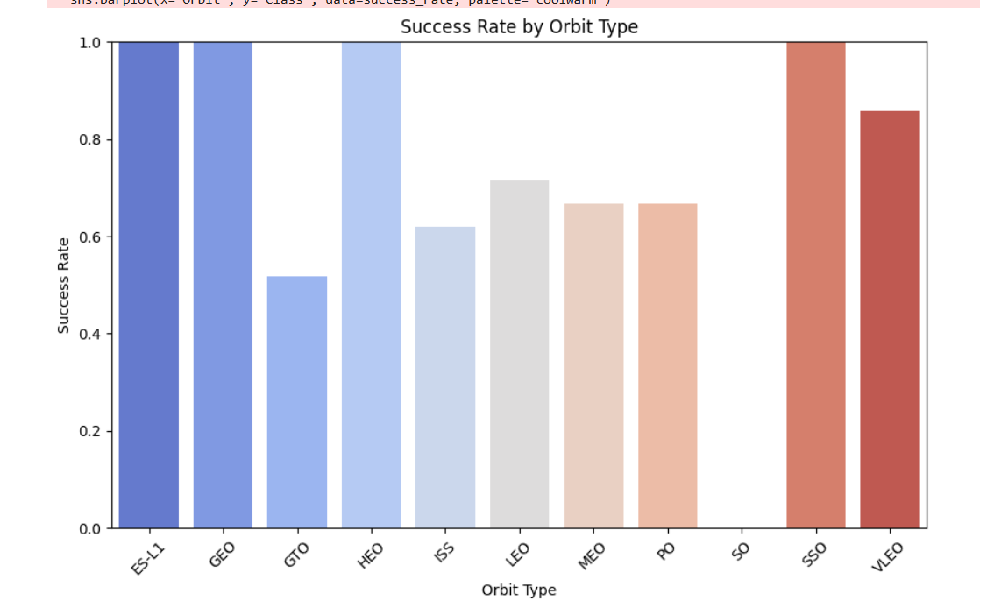
Success Rate vs. Orbit Type
Show a bar chart for the success rate of each orbit type
Bar chart displaying success rates for each orbit type
X-axis: Orbit types (e.g., LEO, GTO, ISS)
Y-axis: Success rate (%)
Helps compare which orbits had the highest mission success
Useful for identifying reliable orbit categories for future launches
Show the screenshot of the scatter plot with explanations

Slide 21
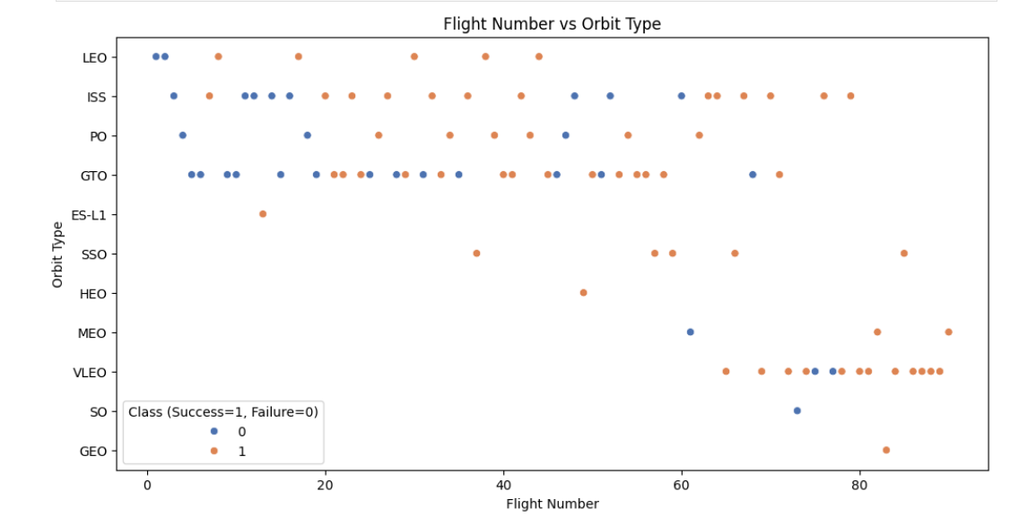
Flight Number vs. Orbit Type
Show a scatter point of Flight number vs. Orbit type
Show the screenshot of the scatter plot with explanations

Slide 22
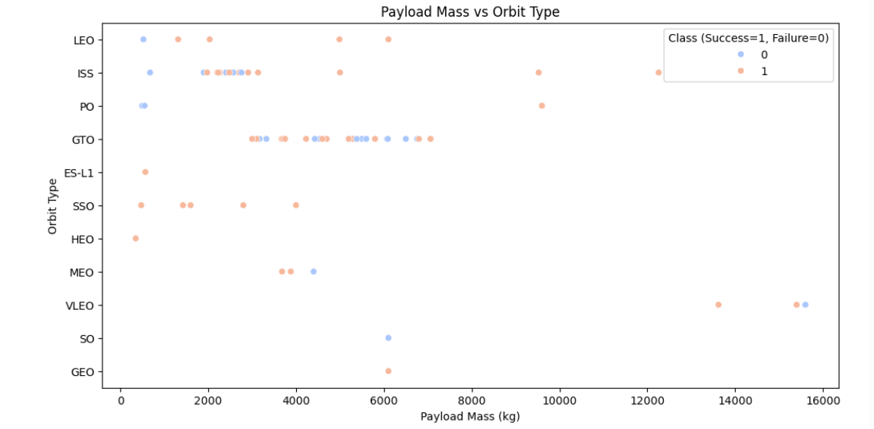
Payload vs. Orbit Type
Show a scatter point of payload vs. orbit type
Show the screenshot of the scatter plot with explanations

Slide 23
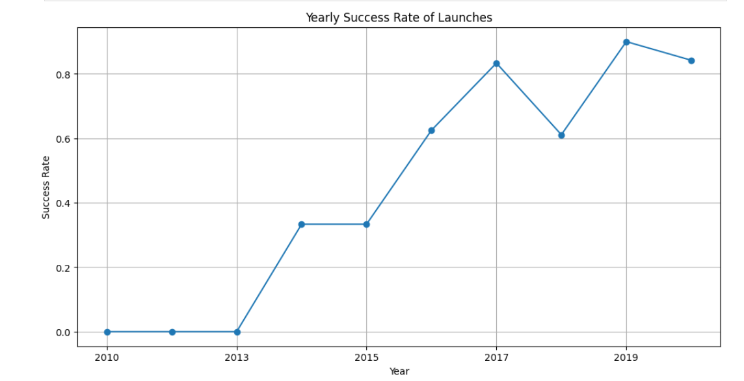
Launch Success Yearly Trend
Show a line chart of yearly average success rate
Show the screenshot of the scatter plot with explanations

Slide 24
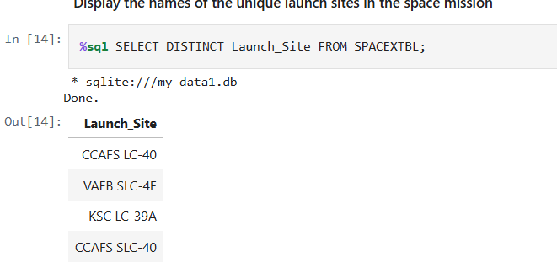
All Launch Site Names
Find the names of the unique launch sites
Present your query result with a short explanation here
This query retrieves all unique launch site names from the dataset. It helps us identify the different locations used by SpaceX for launches, which is crucial for site-specific analysis like success rate, frequency, and payload trends.

Slide 25
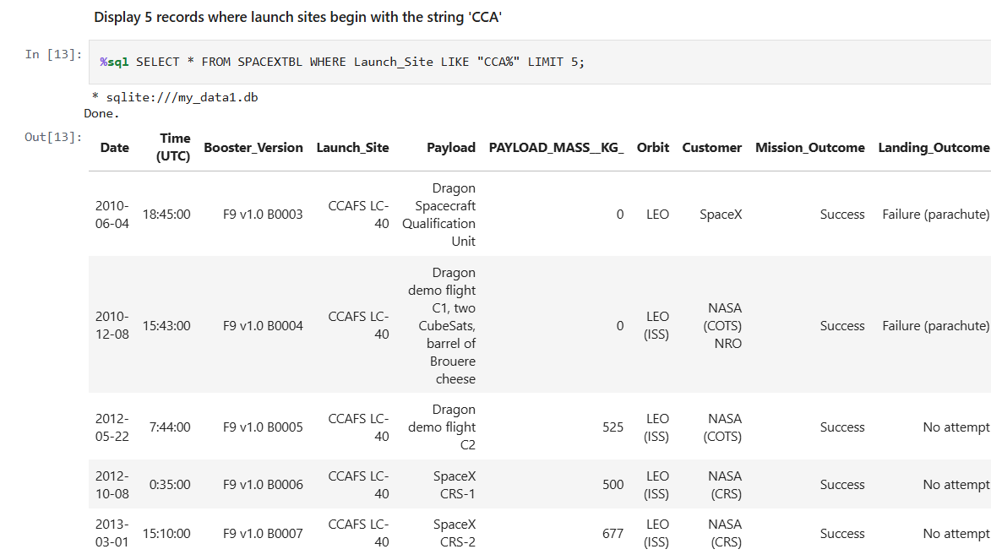
Launch Site Names Begin with 'CCA'
Find 5 records where launch sites begin with `CCA`
Present your query result with a short explanation here

Slide 26
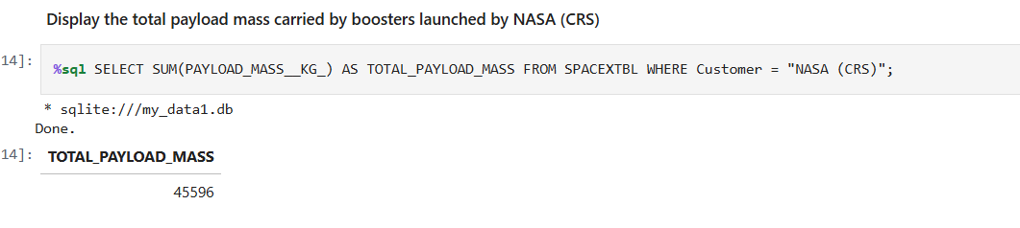
Total Payload Mass
Calculate the total payload carried by boosters from NASA
Present your query result with a short explanation here

Slide 27
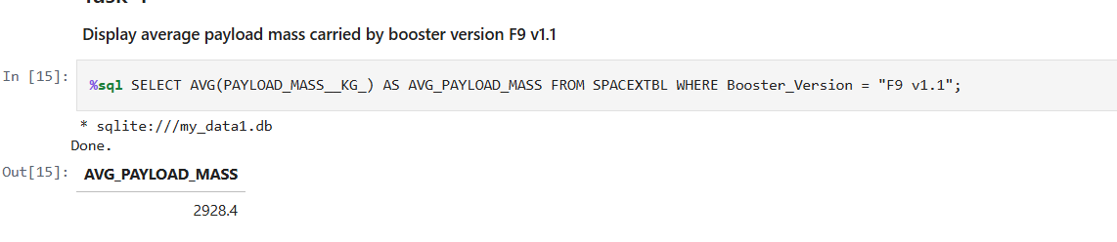
Average Payload Mass by F9 v1.1
Calculate the average payload mass carried by booster version F9 v1.1
Present your query result with a short explanation here

Slide 28
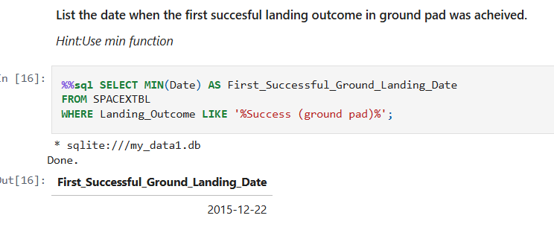
First Successful Ground Landing Date
Find the dates of the first successful landing outcome on ground pad
Present your query result with a short explanation here

Slide 29
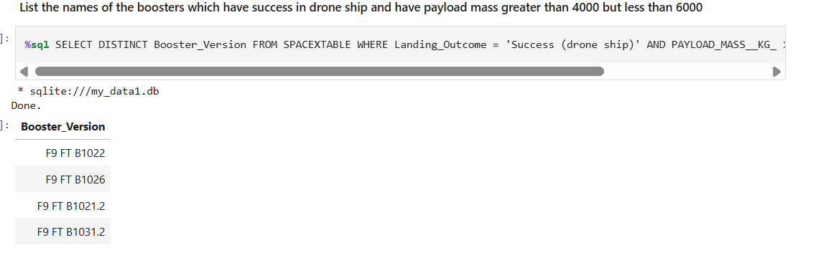
Successful Drone Ship Landing with Payload between 4000 and 6000
List the names of boosters which have successfully landed on drone ship and had payload mass greater than 4000 but less than 6000
Present your query result with a short explanation here

Slide 30
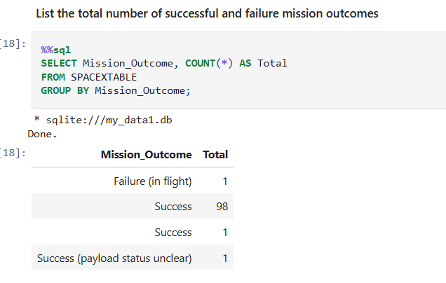
Total Number of Successful and Failure Mission Outcomes
Calculate the total number of successful and failure mission outcomes
Present your query result with a short explanation here

Slide 31
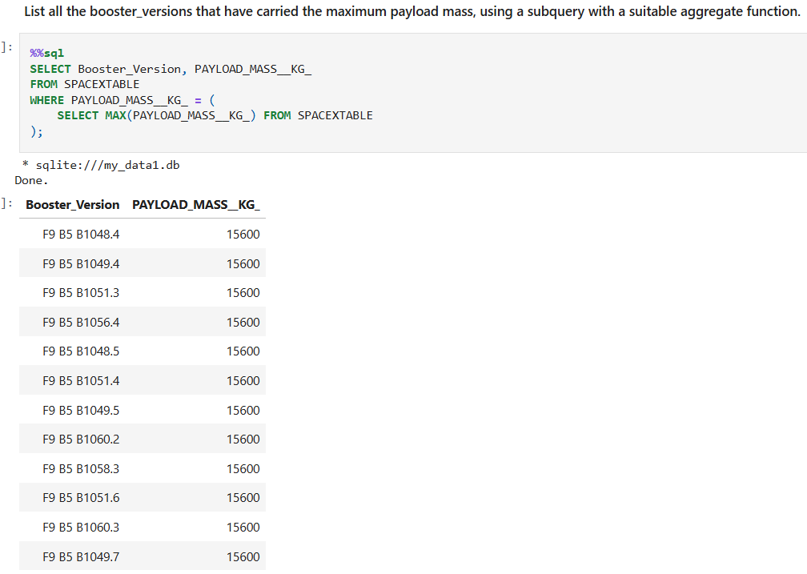
Boosters Carried Maximum Payload
List the names of the booster which have carried the maximum payload mass
Present your query result with a short explanation here

Slide 32
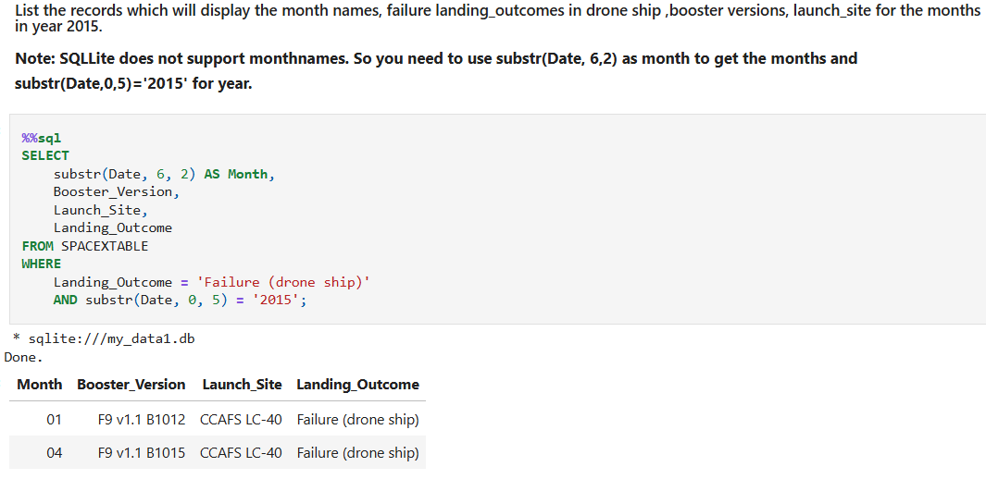
2015 Launch Records
List the failed landing_outcomes in drone ship, their booster versions, and launch site names for in year 2015
Present your query result with a short explanation here

Slide 33
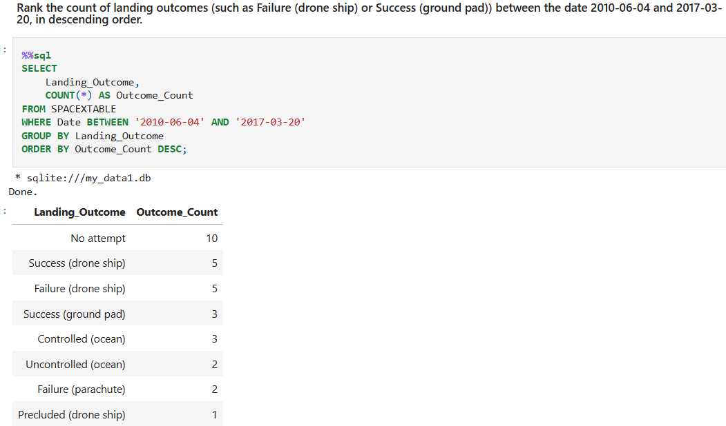
Rank Landing Outcomes Between 2010-06-04 and 2017-03-20
Rank the count of landing outcomes (such as Failure (drone ship) or Success (ground pad)) between the date 2010-06-04 and 2017-03-20, in descending order
Present your query result with a short explanation here

Slide 34

Section 3

Slide 35
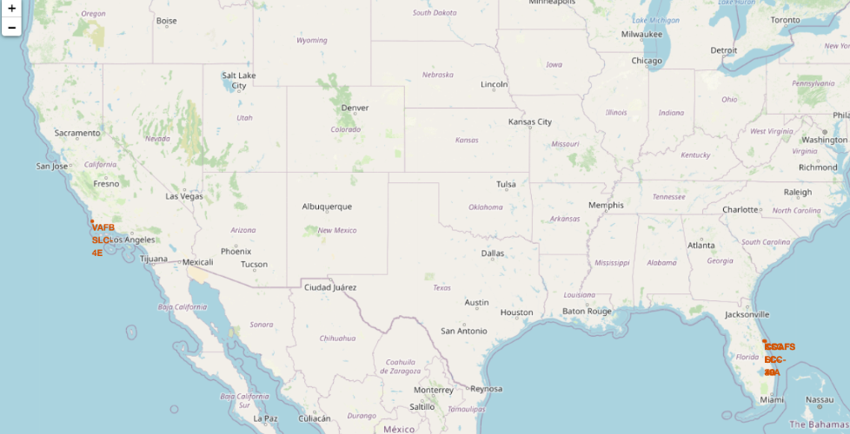
<Folium Map Screenshot 1>
Replace <Folium map screenshot 1> title with an appropriate title
Explore the generated folium map and make a proper screenshot to include all launch sites’ location markers on a global map
Explain the important elements and findings on the screenshot

Slide 36
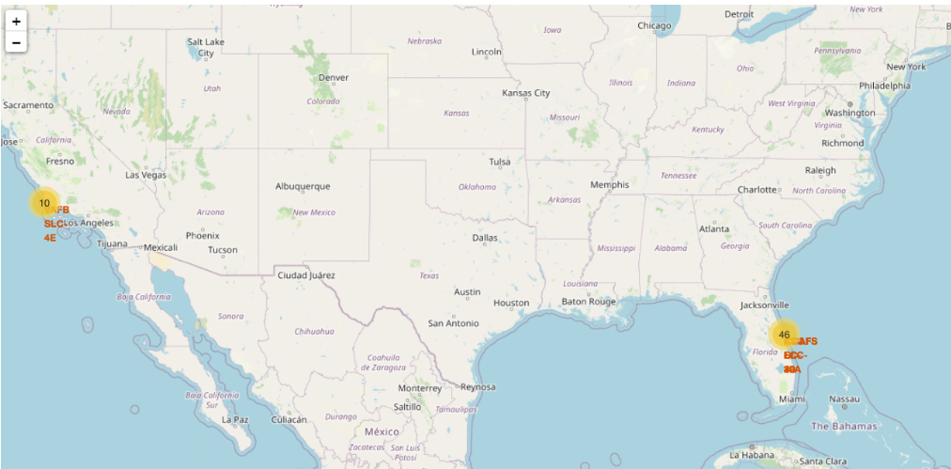
<Folium Map Screenshot 2>
Replace <Folium map screenshot 2> title with an appropriate title
Explore the folium map and make a proper screenshot to show the color-labeled launch outcomes on the map
Explain the important elements and findings on the screenshot

Slide 37
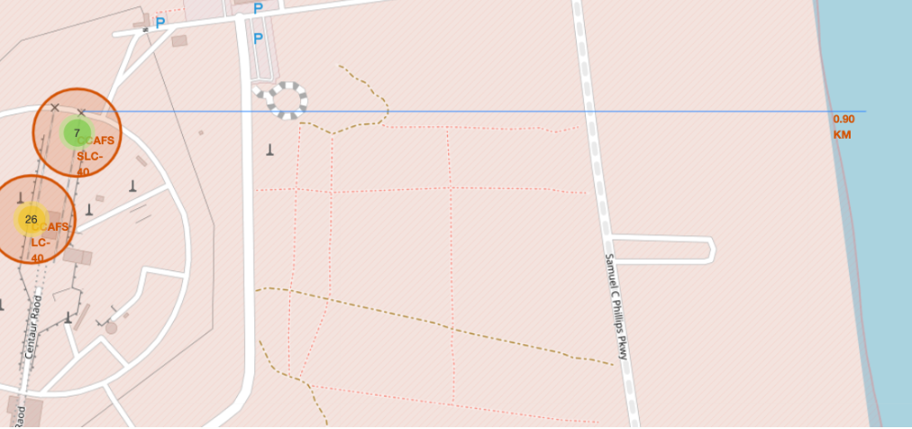
<Folium Map Screenshot 3>
Replace <Folium map screenshot 3> title with an appropriate title
Explore the generated folium map and show the screenshot of a selected launch site to its proximities such as railway, highway, coastline, with distance calculated and displayed
Explain the important elements and findings on the screenshot

Slide 38

Section 4

Slide 39
<Dashboard Screenshot 1>
Replace <Dashboard screenshot 1> title with an appropriate title
Show the screenshot of launch success count for all sites, in a piechart
Explain the important elements and findings on the screenshot

Slide 40
<Dashboard Screenshot 2>
Replace <Dashboard screenshot 2> title with an appropriate title
Show the screenshot of the piechart for the launch site with highest launch success ratio
Explain the important elements and findings on the screenshot

Slide 41
<Dashboard Screenshot 3>
Replace <Dashboard screenshot 3> title with an appropriate title
Show screenshots of Payload vs. Launch Outcome scatter plot for all sites, with different payload selected in the range slider
Explain the important elements and findings on the screenshot, such as which payload range or booster version have the largest success rate, etc.

Slide 42

Section 5

Slide 43
Classification Accuracy
Visualize the built model accuracy for all built classification models, in a bar chart
Find which model has the highest classification accuracy

Slide 44
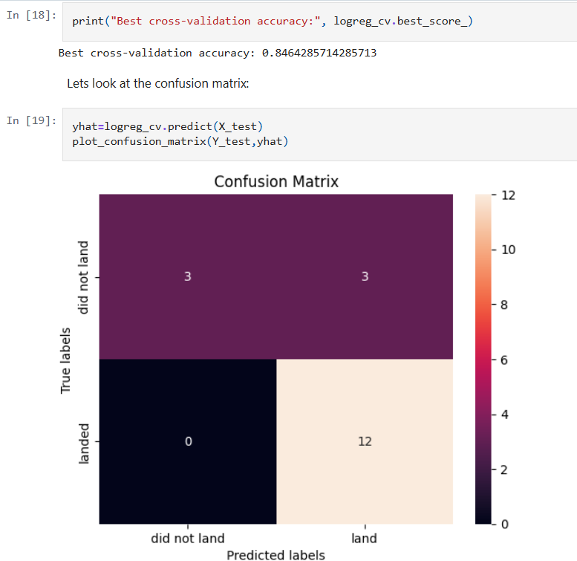
Confusion Matrix
Show the confusion matrix of the best performing model with an explanation

Slide 45
Conclusions
Most launches took place from KSC LC 39A and CCAFS SLC 40, indicating these as primary launch sites.
Orbit type significantly affects success rate — LEO and GTO have higher success rates.
Payload mass influences mission outcome — heavier payloads have a slightly lower success rate.
The best-performing classifier was Logistic Regression, with the highest test accuracy.
Interactive maps and dashboards provided insightful visual analysis of launch locations and outcomes.

Slide 46
Appendix
Include any relevant assets like Python code snippets, SQL queries, charts, Notebook outputs, or data sets that you may have created during this project

Slide 47


